Slide 1
HOMEWORK 4
Create a comma separated value file that contains three columns of data where the secondand third columns contain the square and cube of the number in the first column, respectively. You can do it manually or using a shell script. Create an awk script that reads each line and prints out thesum of all three columns as the fourth column. In the last line the average of each of the four columns shall be printed out along with a remark on how many lines have been processed.

Slide 2
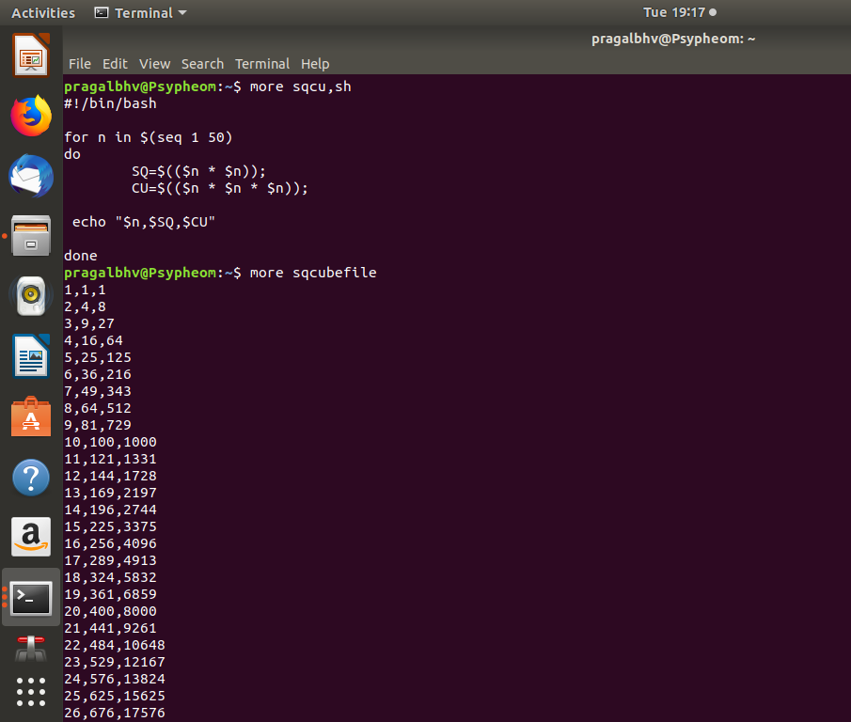
Code and data file

Slide 3
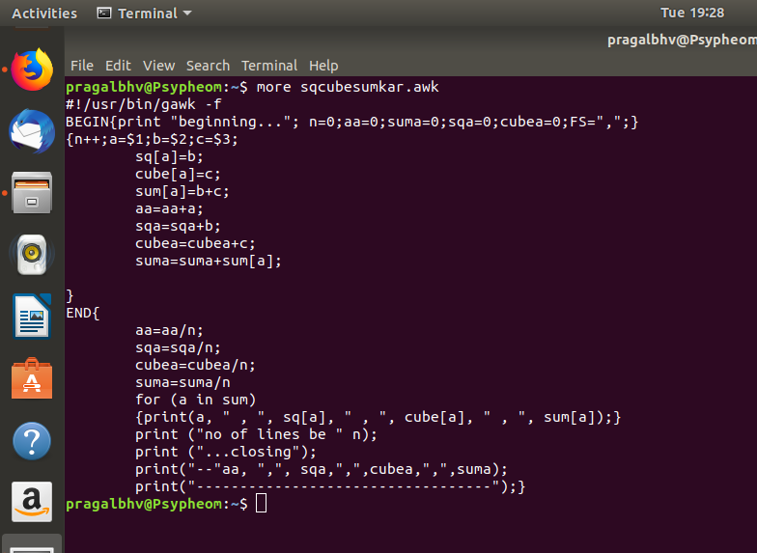
Awk file

Slide 4
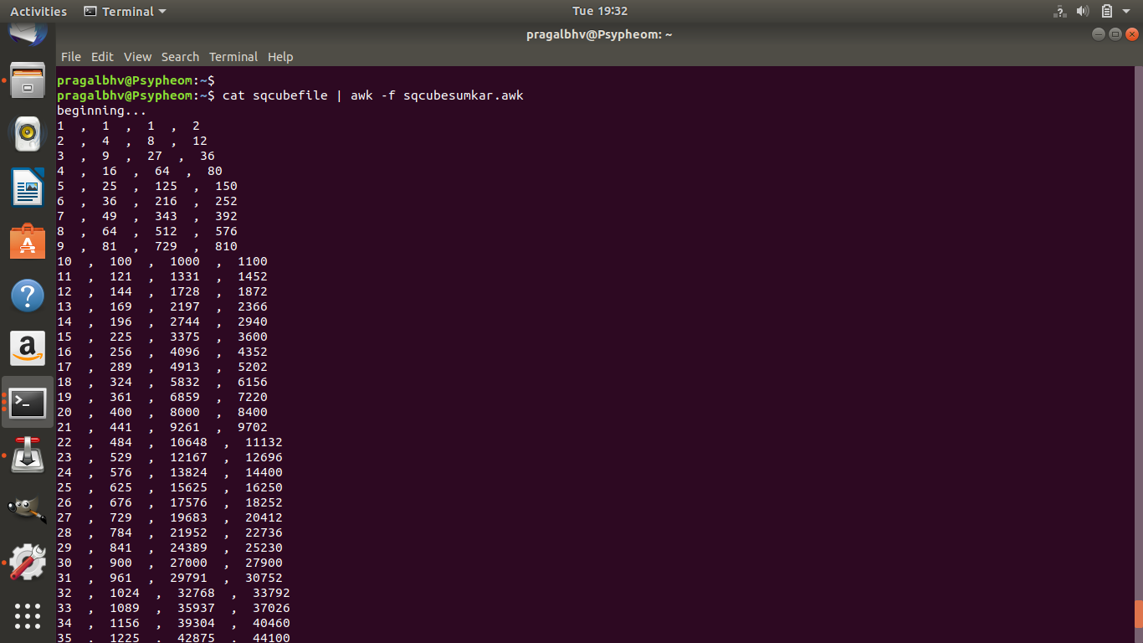
output

Slide 5
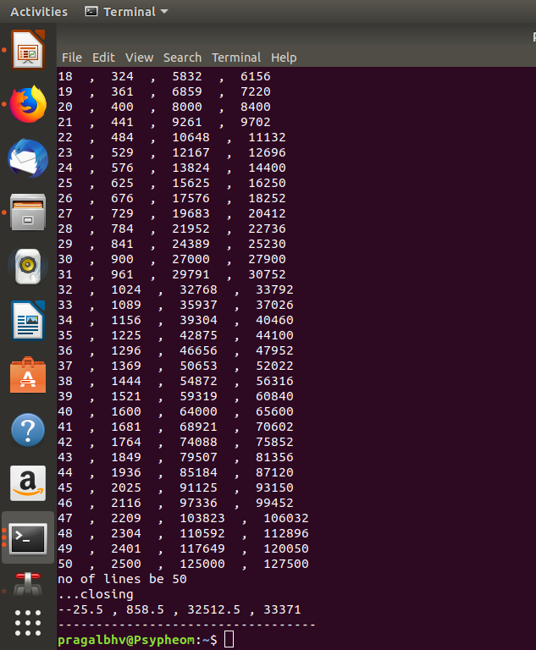
output

